Slide 1
Airspace FACC update 9th February 2023
AHEAD OF THE CURVE

Slide 2
PIR FACC update 9th February 2023
AHEAD OF THE CURVE

Slide 3
Update and current important dates
Data gathering ends
31st March 2023
FAL report to CAA submitted by
28th April 2023
CAA upload the report to the webpage as soon as practicable…this opens the 28 day feedback window
CAA have 3 months from our submission to produce the CAA Post Implementation Review - deadline
31st July 2023
We expect our report to the CAA to be uploaded to this page Farnborough Airport airspace change proposal | Civil Aviation Authority (caa.co.uk)
Due to recent feedback received from FACC we are working with EVS, the WebTrak supplier to provide more information on WebTrak:
We hope this information will consist of airspace information, laterally defined shapes with a key to show the vertical information, all of which is taken from the ACP implementation documentation.
If we can achieve this, then stakeholders will be able to select information and identify whether the aircraft that is of interest to them is operating in accordance with what the ACP submission stated.

Slide 4
FASI-(S) ACP FACC update 9th February 2023
AHEAD OF THE CURVE

Slide 5
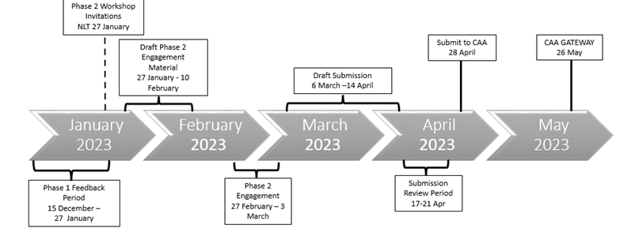
We had our Assessment Meeting with the CAA the day after the last FACC. The meeting was successful, and the details can be viewed on the CAA portal Airspace change proposal public view (caa.co.uk) This enabled us to move into Step 1B but with a slightly different timeline as the CAA could not accommodate our requested Stage 1 Gateway in April.
Stage 1
Draft Timeline prior to Assessment Meeting
Current timeline post Assessment Meeting
1 of 3

Slide 6
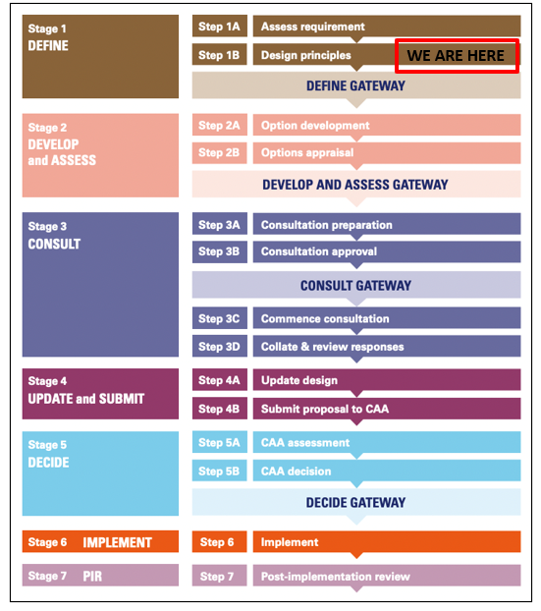
Step 1B
Step 1B: Design Principles
During the Design Principles step, FAL develops the principles which will underpin our proposed options for the change
The design principles encompass the safety, environmental and operational criteria and strategic policy objectives that we aim for in developing the airspace change proposal
They are developed through engagement with stakeholders
Engagement
Workshops
F2F
Thursday 8th December
Online
Friday 9th December
F2F
Monday 12th December
Online
Tuesday 13th December
Workshops:
The invitees to these workshops were a mixture of members from Borough Councils & Unitary Authorities, County Councils, Community and Aviation Stakeholders, Environmental Groups and other airports

Slide 7
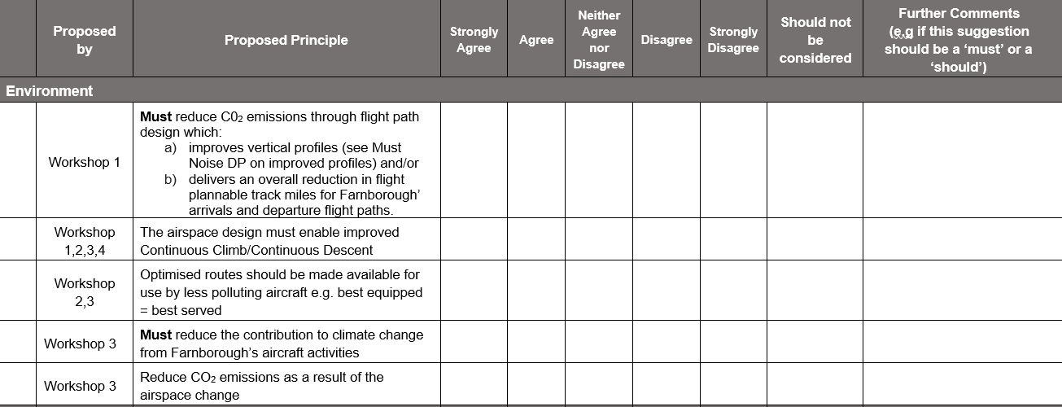
Step 1B
We completed our first round of Step 1B engagement before Christmas. We contacted over 250 targeted stakeholders offering attendance at our workshops.
At the workshops we set out the possible opportunities (make what we have better) but also explained that the surrounding airports and airfields would continue to operate therefore we still expect aircraft routings to have to interact.
The workshop participants discussed and suggested various design principles based on the following broad themes; safety, policy, noise, environment and airspace/aircraft capabilities/technologies.
After the workshops we sent updated matrix information to the targeted stakeholders asking for views on the proposed design principles gathered. This feedback window was open until 27th January - we received 19 completed matrix responses.

Slide 8
Step 1B
After analysis of the matrix feedback we are now creating a single list of design principles that we propose to use for this airspace change.
There will be more engagement to present the matrix feedback we received and to gather opinions on our proposed list of design principles.
Invitations have been sent to the same 250+ targeted stakeholders.
Additionally, we propose to send out our proposed list of design principles to our targeted stakeholders and offer an additional feedback opportunity to providing a written response.
At the end of all this engagement we will have a set of design principles that we will submit to the CAA along with all the necessary supporting evidence for the DEFINE gateway in May 23.
Engagement
Workshops
F2F
1000
Friday
3 March
Online
1000
Thursday
3 March
Online
1700
Wednesday
1 March

Slide 9
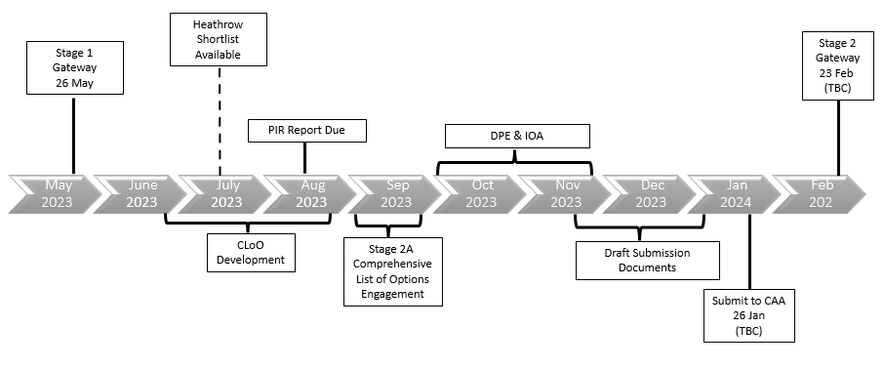
Stage 2
After a request from ACOG to establish a date for a Stage 2 Gateway, FAL has secured a slot in the CAA calendar for February 24.
The timeline, (based on the assumption that we successful move through Gateway 1, and that the CAA PIR does not necessitate further change) is shown below.

Slide 10
Other FASI-S information
As well as working on our ACP, since the last FACC, we have continued to engage with other FASI-S sponsors as stakeholders in their ACPs for example responding to engagement requests.
We have also actively engaged with Blackbushe and with the Airspace Change Organising Group (ACOG).
Websites for info:
We are the Airspace Change Organising Group - Airspace Change Organising Group (ACOG)
Home - One Sky One Plan there is a video here which helps set out the strategic situation.

Slide 11
Ahead of the Curve
AHEAD OF THE CURVE

Slide 12
WEBTRAK
9 February 2023

Slide 13
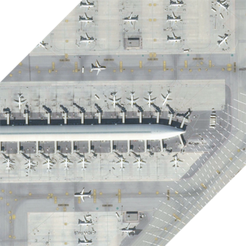
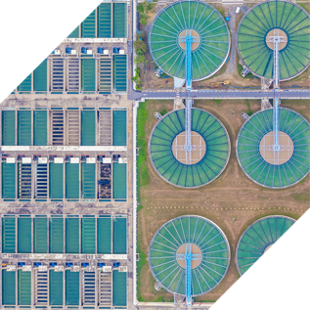
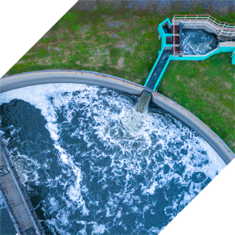
Envirosuite – A global leader in Environmental Intelligence
Airports
Industrial
Mining
Waste
Wastewater
Water Treatment

Slide 14
Over 200 Airport & ANSPs Clients Globally
North America
EMEA
Asia Pacific
Notes:
ANA logo and BEG

Slide 15
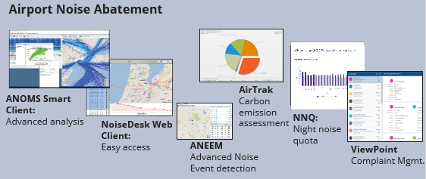
How does Webtrak work?
Data Inputs
Fixed / Semi Permanent NMTs
Weather Sensors
Flight Plans
Radar Data
SSR / MLAT / ADS-B
typically a 30 minute delay for security
Data file Uploader
BuchAir Flight Registry
Surface Radar Data
SMGCS
ANOMS
OPAS

Slide 16
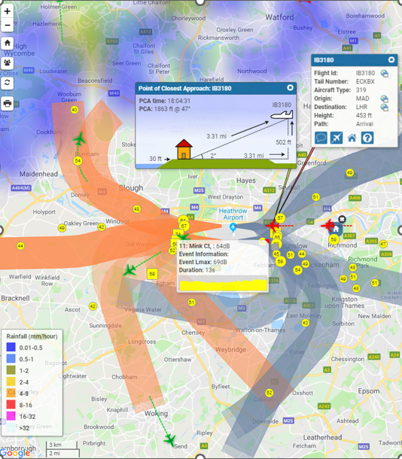
Why Webtrak?
Used at 70+ airports globally
Sydney, Los Angeles, JFK, Toronto, Madrid, Heathrow, Gatwick and Farnborough.
Build community trust by being transparent with data
Begin a fact-based discussion around operations
Personalise the experience
How much noise did that aircraft make?
How close did it get to my house?
Self-investigation via the complaint form
Accurate airport SSR data vs. public ADS-B flight trackers
Highlight non-compliant operations
Based on NoiseDesk infringement rules
Show the effects of weather on operations
Notes:
Other UK & Ireland airports already using ANOMS and WebTrak are: BOH, BQH, FAB, LPL, BHX, LHR, LGW, MAN, STN, EMA and BRS and DUB, as well as SEN, NCL, ABZ, GLA, and SOU.

Slide 17
Thank you for listening.

