Slide 1
Airspace FACC Update March 2024
AHEAD OF THE CURVE

Slide 2
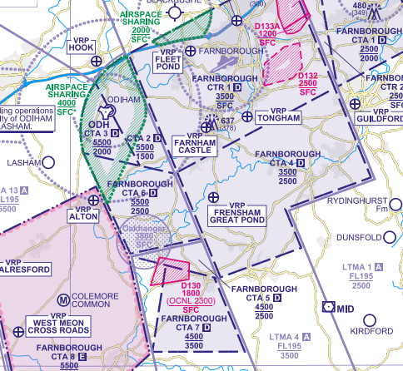
2020 ACP - PIR update
After a request from the CAA to clarify the usage of CTA 7 information has been provided to them and they are working through it.
We expect that this will require an updated version of Annex E.

Slide 3
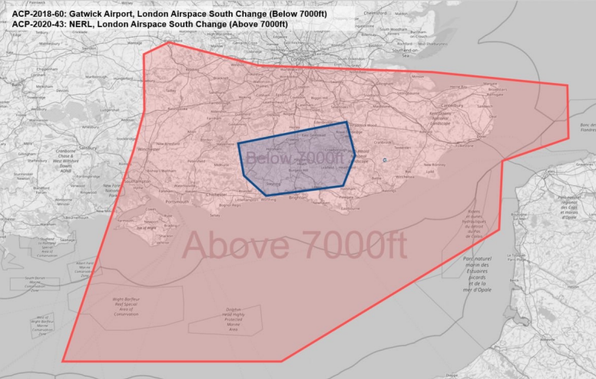
FASI-S Update
General
CAA and DFT planning to establish a Single Design Entity (SDE). Will need public consultation and does risk delay to the overall programme.
ACOG have 2 Public Engagement Exercises live – one for the Scottish element and one for London Airspace South – this was launched 12 Feb and concerns airspace below 7000’ sponsored by Gatwick and above 7000’ sponsored by NERL (this extends over us).
Our ACP
Engagement feedback window for our Stage 2 options closed 26 Jan 24.
In scope feedback has been assessed. No further options have been identified.
Most of the feedback did not answer the specific questions asked.
Those mentioning our Design Principles felt they were not able to say whether the design options had been followed or stated that they believed they hadn’t been considered.
Therefore, we have decided to provide additional information to our targeted stakeholders. This second engagement period is currently planned for the end of April and into May.
The options have been technically refined to allow us to fulfill the next element of the Stage 2 process: an assessment of our options against our design principles known as the Design Principles Evaluation (DPE) is underway and an Initial Options Appraisal (IOA) is planned for June.
Technical integration work with other AMS ACP’s is progressing.

Slide 4
Ahead of the Curve
AHEAD OF THE CURVE

